Slide 1
Auto Course Advising System
Presented to:
Md. Abu Rumman Refat
Lecturer Dept. of CSE
Green University of Bangladesh
Presented by:
Md. Sabbir Hossain
Id: 221902126

Slide 2
1
Content
Introduction
Part of the project
Diagram
Login System
Portal System
Project developing
Advantage
limitation
Reference

Slide 3
2
Introduction
An Automated Course Advising System has been advised to guide students in selecting appropriate courses suitable to online registration.

Slide 4
3
Part of the Project
Login System
Portal System

Slide 5
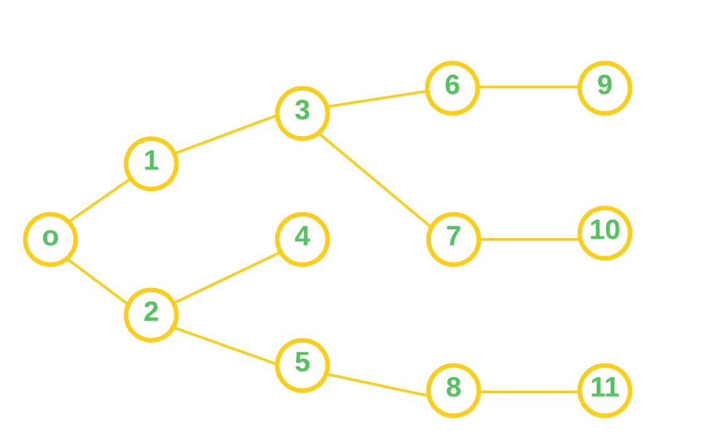
4
Diagram

Slide 6
5
Diagram
Log In
Home Page
Course Advising
Result History
Class Routing
Bill History

Slide 7

6
Login System
Login system is the procedure used to get access to an application.
Figure 1: Login page

Slide 8
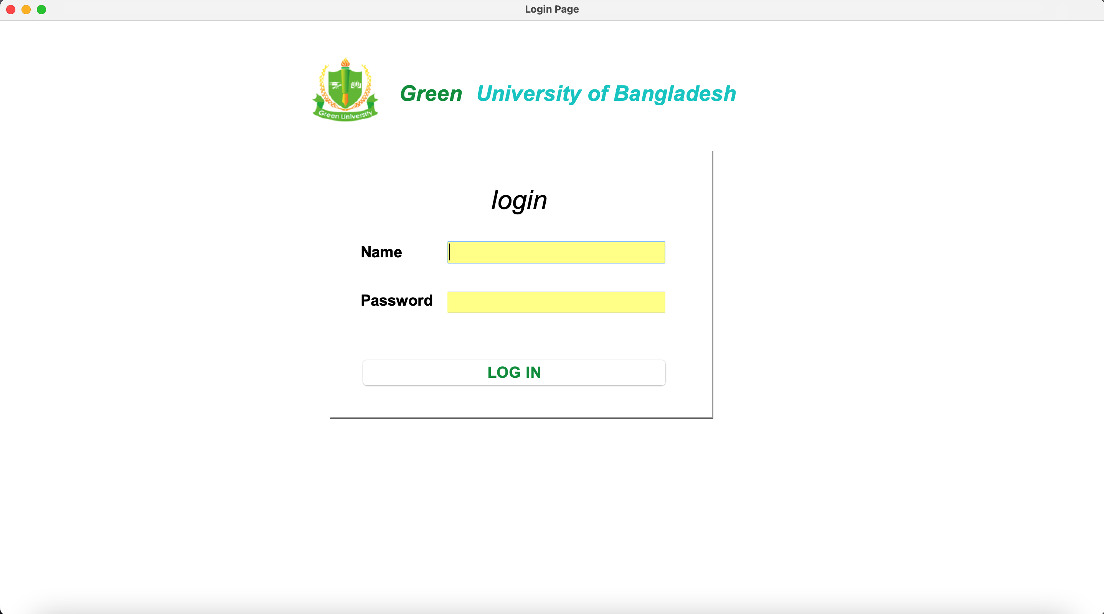

7
Login System
Figure 2.2: Login
Figure 2.1: Login page

Slide 9
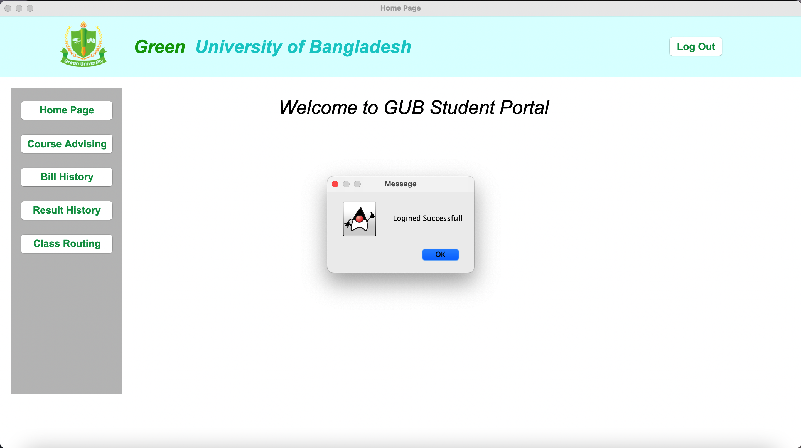
8
Portal System
Figure 3.1: Home page

Slide 10
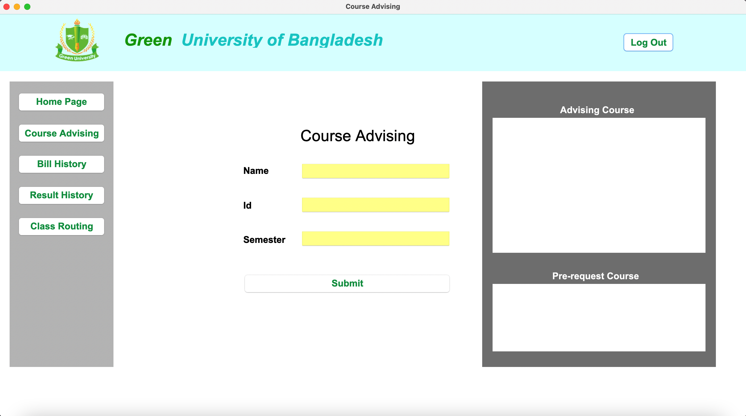
9
Portal System
Figure 4.1: Course Advising

Slide 11
10
Project Developing
Java Language
Java Swing for GUI
OOP Concept
BFS Algorithm
Operating System
Xampp Server
IntelliJ IDE

Slide 12
11
Advantage
It has many advantage :
Student can’t face any problem to take their next semester course.
New students will know the student portal facility.
Student will also know security system of student portal.
A new student can’t face any problem to Pre-registration.
No needed Advisor.

Slide 13
12
limitation
It has some Limitation :
String limitation
Without database not working
Student can not see their details

Slide 14
13
Reference
Anisul Islam YouTube
https://www.youtube.com/@anisul-islam
GeeksforGeeks
https://www.geeksforgeeks.org
Javapoint
https://www.javatpoint.com/java-swing

Slide 15
Project Show

Slide 16
Thank You

